Slide 1
Strawman Flight Plans and their relevance to Science Objectives:
Joon Young Ahn, Gangwoong Lee Jay Al-Saadi, Jim Crawford

Slide 2
Flight Goals in Support of Science Objectives
Question 1. What are the challenges and opportunities for satellite observations of air quality?
Question 1a. How do synoptic conditions (outflow, convection, stagnation, etc.) affect the vertical distribution of trace gases and aerosols?
Flights need to span a wide range of meteorological conditions.
Question 1b. How do pollutant distributions relate to cloud cover?
Flights need to include some cloudy periods when remote sensing is not possible.
Question 1c. How does aerosol abundance and vertical distribution influence trace gas retrievals?
Flights needs to interact with ground sites to examine in situ versus remotely sensed trace gases under a range of ambient AOD.
Question 1d. How does the land/water boundary influence aerosol retrievals?
Flights need to characterize in situ aerosol composition and properties as well as AOD over water versus land.

Slide 3
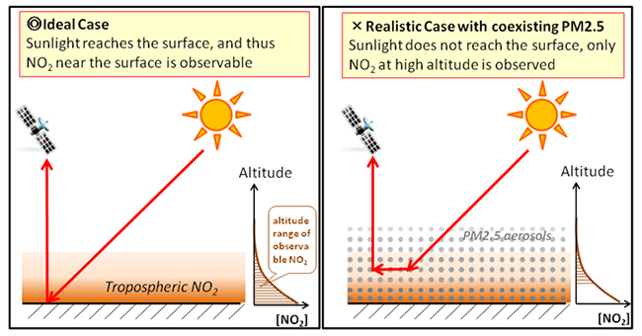
Example of Remote Sensing Challenges due to Aerosol Effects
Figure 10. Conceptual diagram of shielding effect caused by co-existing PM2.5 aerosols. Co-existing PM2.5 aerosols prevent sunlight from reaching the earth’s surface. As a result, satellite observation fails to detect NO₂ near the Earth’s surface.
Taken from Kanaya et al. (http://www.jamstec.go.jp/e/about/press_release/20140811/)

Slide 4
Flight Goals in Support of Science Objectives
Question 2. What are the most important factors governing ozone photochemistry and aerosol evolution?
Question 2a. How does ozone photochemistry respond to the various mixtures of upwind versus local pollutant emissions, biogenic emissions, and marine emissions?
Flights needs to cover a wide range of geographic and meteorological conditions.
Question 2b. What do aerosol physical, optical, and chemical properties reveal about the interaction between ozone photochemistry and secondary aerosol formation?
Flights need to include comprehensive in situ observations of ozone, ozone precursors, and aerosol properties and composition.

Slide 5
Flight Goals in Support of Science Objectives
Question 3. How do models perform and what improvements are needed to better represent atmospheric composition over Korea and its connection to the larger global atmosphere?
Question 3a. Are modeled gradients across the Korean peninsula consistent with local/upwind sources, transport, and chemistry?
Flights need to cross important boundaries between the Seoul Metropolitan Area, rural regions, and surrounding waters.
Question 3b. Are air quality and atmospheric chemistry forecasting systems prepared to utilize GEO observations?
Flights need to broadly sample across the region and in coordination with ground sites to assess models and assimilation of independent observations.

Slide 6
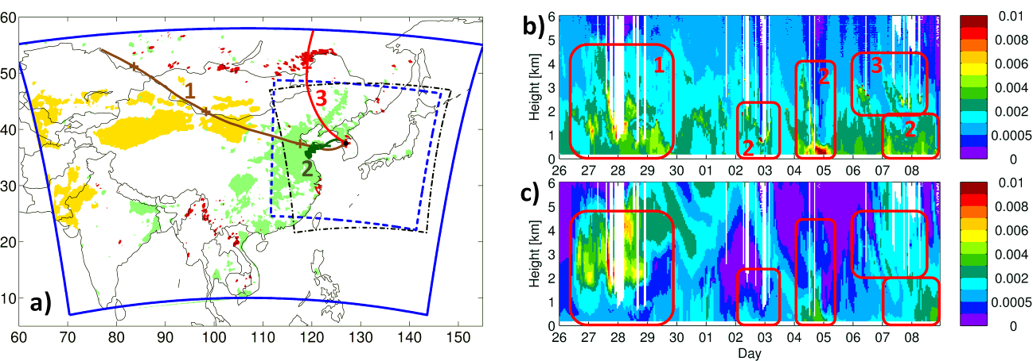
Example supporting the need for Model Evaluation
Figure 11. Left panel: Source and trajectory paths for the types of pollution episodes expected during KORUS-AQ. Boxes outline the GOCI field of view (dashed black) and proposed modeling domains (blue). These sources affected Korea for a 2-week period during April-May 2012 and correspond to dust (yellow), anthropogenic pollution (green) and biomass burning smoke (dark red), with corresponding representative trajectories in brown (1), dark green (2) and red (3). Plus signs mark 1-day increments along the trajectories. Right panels: Observed (b) and modeled (c) attenuated Lidar backscattering at Seoul National University station (black circle on the map). Red boxes represent the different pollution episodes associated with each numbered source trajectory. From Saide et al., 2014.

Slide 7
Consolidated Flight Goals in Support of Science Objectives and Related Questions
All of the questions can be satisfied with broad sampling that includes upwind-downwind , marine-continental, urban-rural environments at multiple altitudes and under diverse meteorological conditions.
Obtaining this diversity calls for repetitive sampling over the same paths and locations over the six week study period.

Slide 8
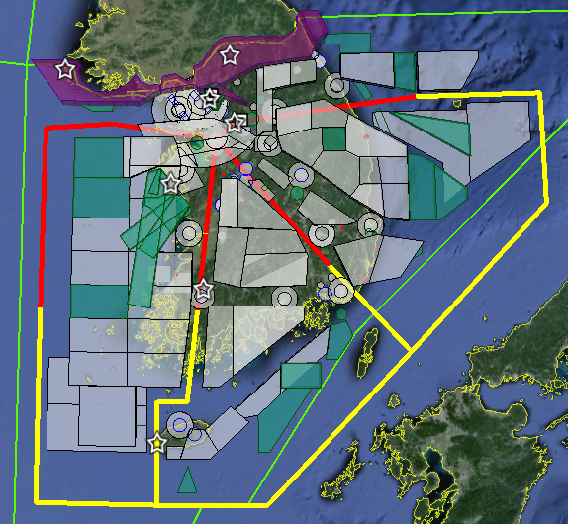
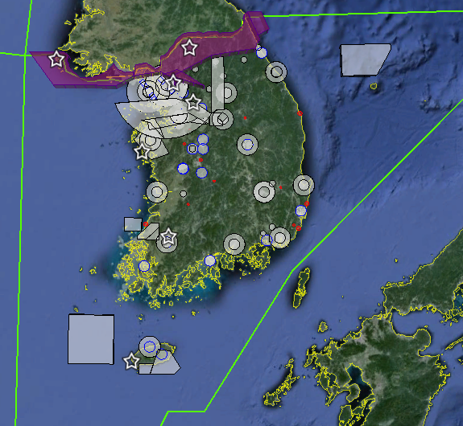
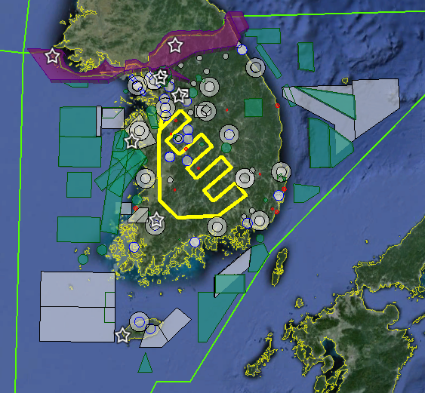
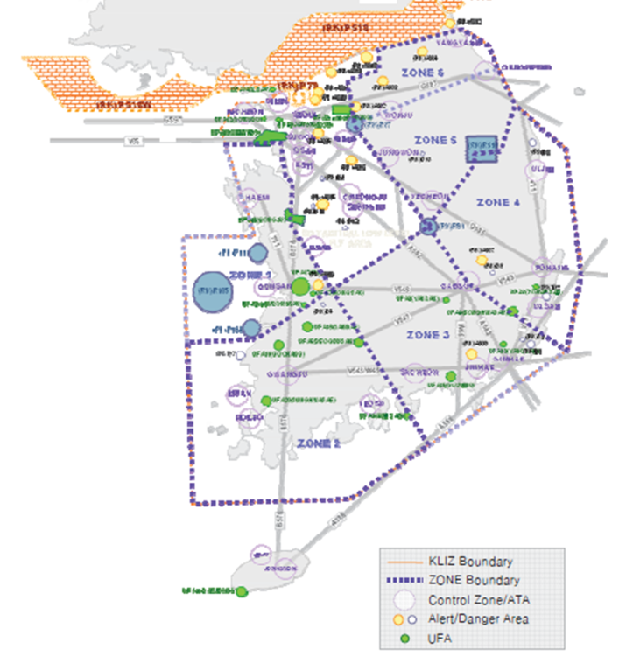
Flight planning considerations: Special-use airspace varies by day and altitude
Weekday
worst case
Weekend
best case
Below 3,000 ft
Below 3,000 ft
Notes:
Figure 13. Special use airspace within the South Korean FIR (green border) for weekdays (top left) and weekends (top right). Flight areas to support military operations and training are not active on weekends, offering greater flexibility for sampling. Flight lines (shown in red and yellow) indicate potential lanes for survey sampling that should be feasible on any day (see discussion in text). Low altitude flight (below 3000 ft) to sample near-surface pollution is more broadly feasible as only a subset of special use airspace extends to the surface (bottom left). Instead, low altitude flight is regulated by the ROK Air Force across six zones (bottom right).

Slide 9
DC-8 Flight Sampling Considerations
Repetitive sampling along corridors through special airspace (jetways) is the most workable strategy
The red lines represent the extent to which the DC-8 could explore four of these corridors in an 8-hour flight with transects at four different altitudes.
Advice from Osan staff indicate that flying an IFR flight plan without deviation is the best chance to get what we want.
Specific flight plans choosing which portion of the jetways to sample would be filed the afternoon before each flight day.

Slide 10
Vertical sampling strategy along the jetways
1. Transect at 18 kft (lidar survey)
2. In-progress descent
5. Transect at an intermediate altitude (~3-8 kft?)
4. Spiral ascent
3. Transect at 1000 ft
Notes:
What lidar data would be available to help decide on the intermediate altitude? Both climatological and real-time information would be useful.

Slide 11
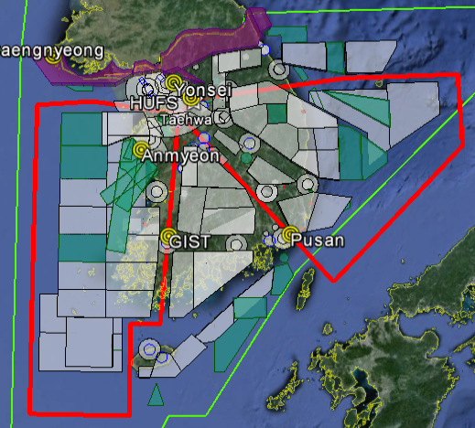
NASA King Air Flight Sampling Considerations (1)
The King Air will conduct remote sensing from 28 kft.
Sampling along the same corridors as the DC-8 would maximize integration into the larger sampling strategy.
The King Air flies slower than the DC-8, but it does not need to cover the same ground at multiple altitudes.
In 4 hours, the King Air could cover one of the two loops depicted in the figure to the right.
With two 4 hour flights per day, the King Air could cover all four corridors and have some coincidence with the DC-8 along each corridor.
Notes:
The west loop could be considered the “Transboundary” loop and the east loop could be considered the “Evolution” loop. One might consider a third loop just over the peninsula.

Slide 12
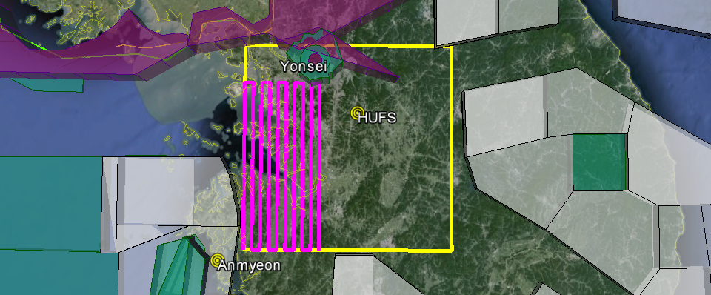
NASA King Air Flight Sampling Considerations (2)
This image only shows special use airspace that extends above 20 kft. This opens a possible area over the Seoul Metropolitan Area (yellow box) to fly a pattern for mapping pollution. The magenta line shows the area that could be covered by the King Air in one sortie.

Slide 13
Strawman Flight Plans and their relevance to Science Objectives for Hanseo King Air

Slide 14
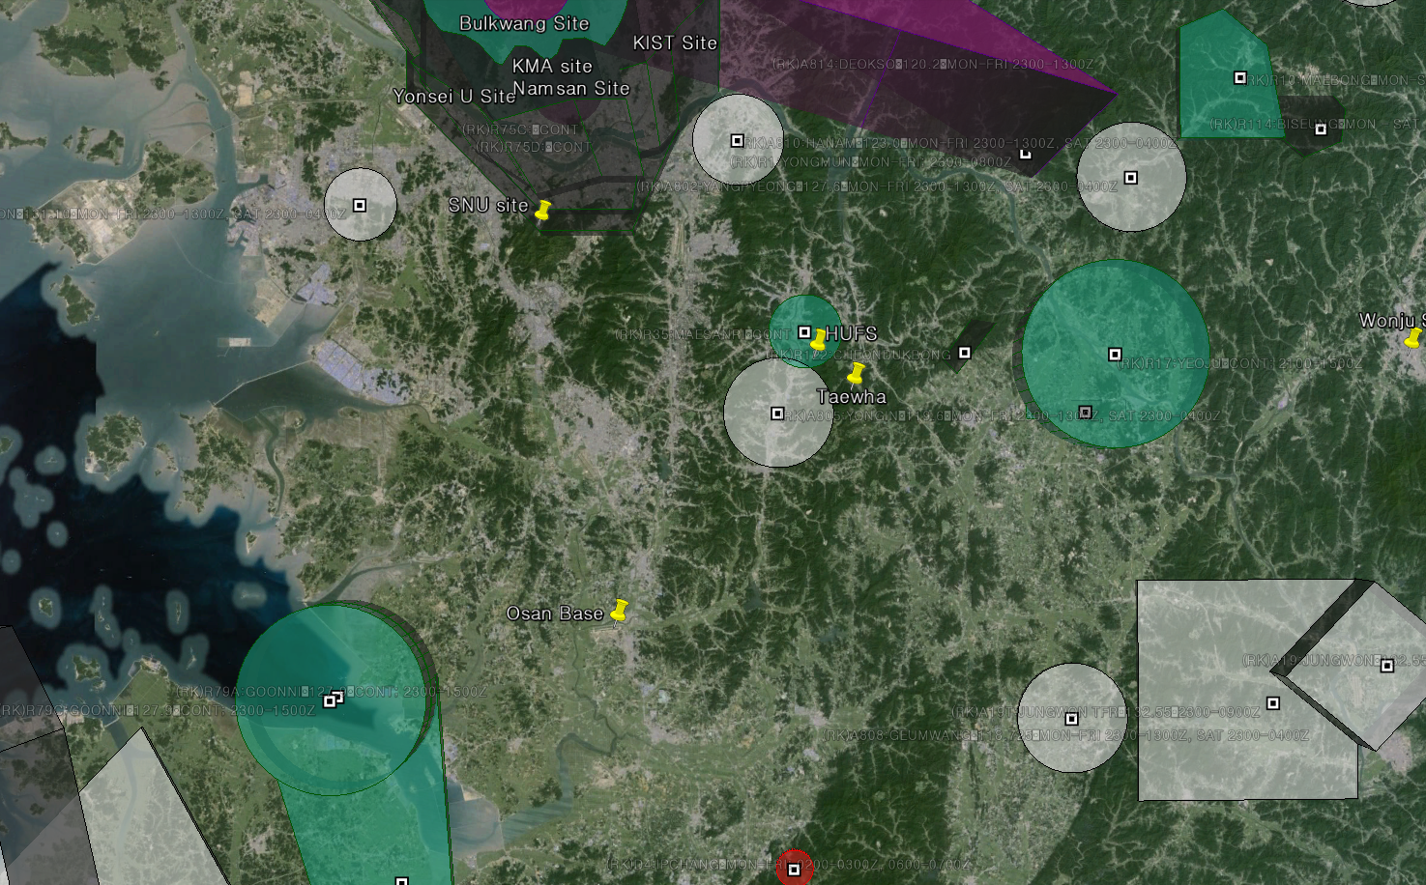
SMA in and Out

Slide 15
SMA in and out fast advection case

Slide 16
SMA in and out slow advection case

Slide 17
ground site intercomparison and urban plume

Slide 18
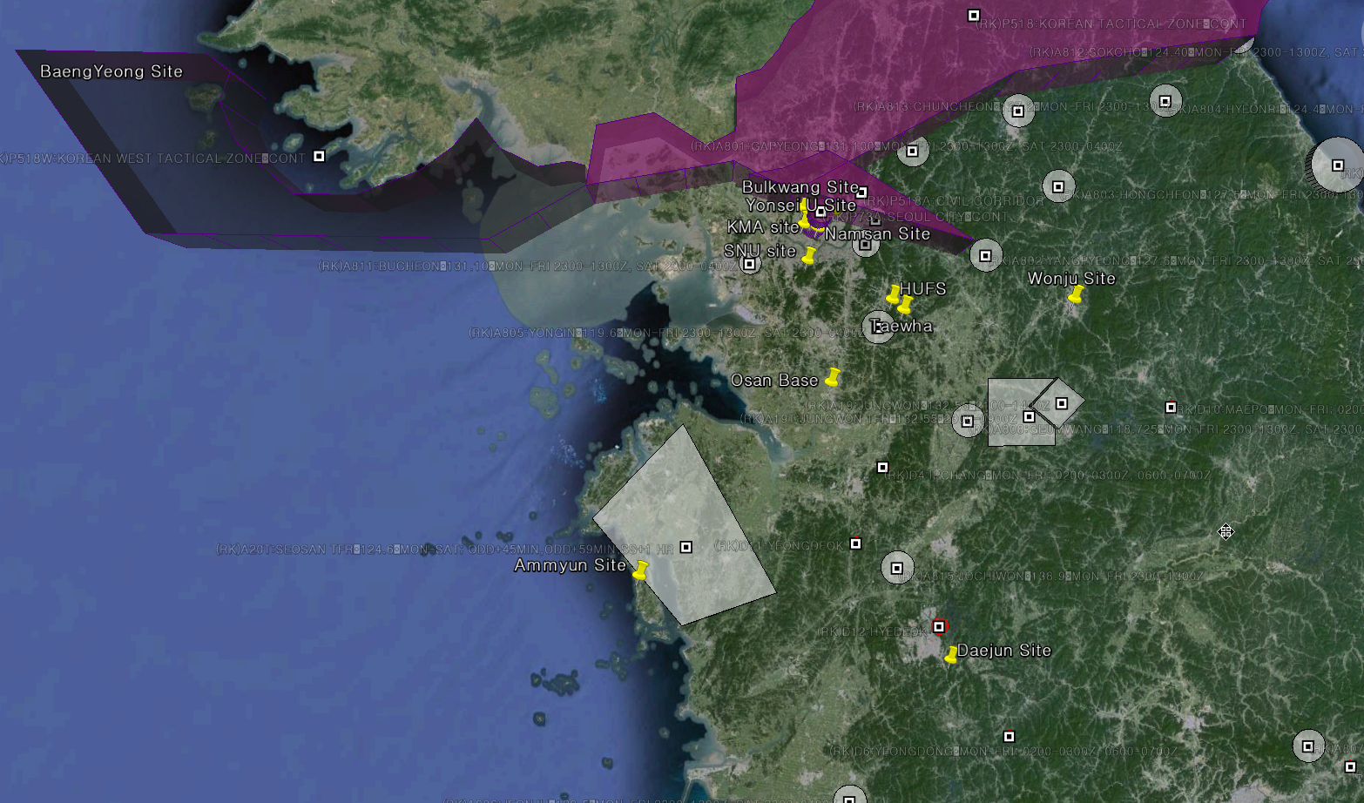
Weekend Scenario Giga Power plants and point sources

Slide 19
Weekend Scenario boundary layer transport case

Slide 20
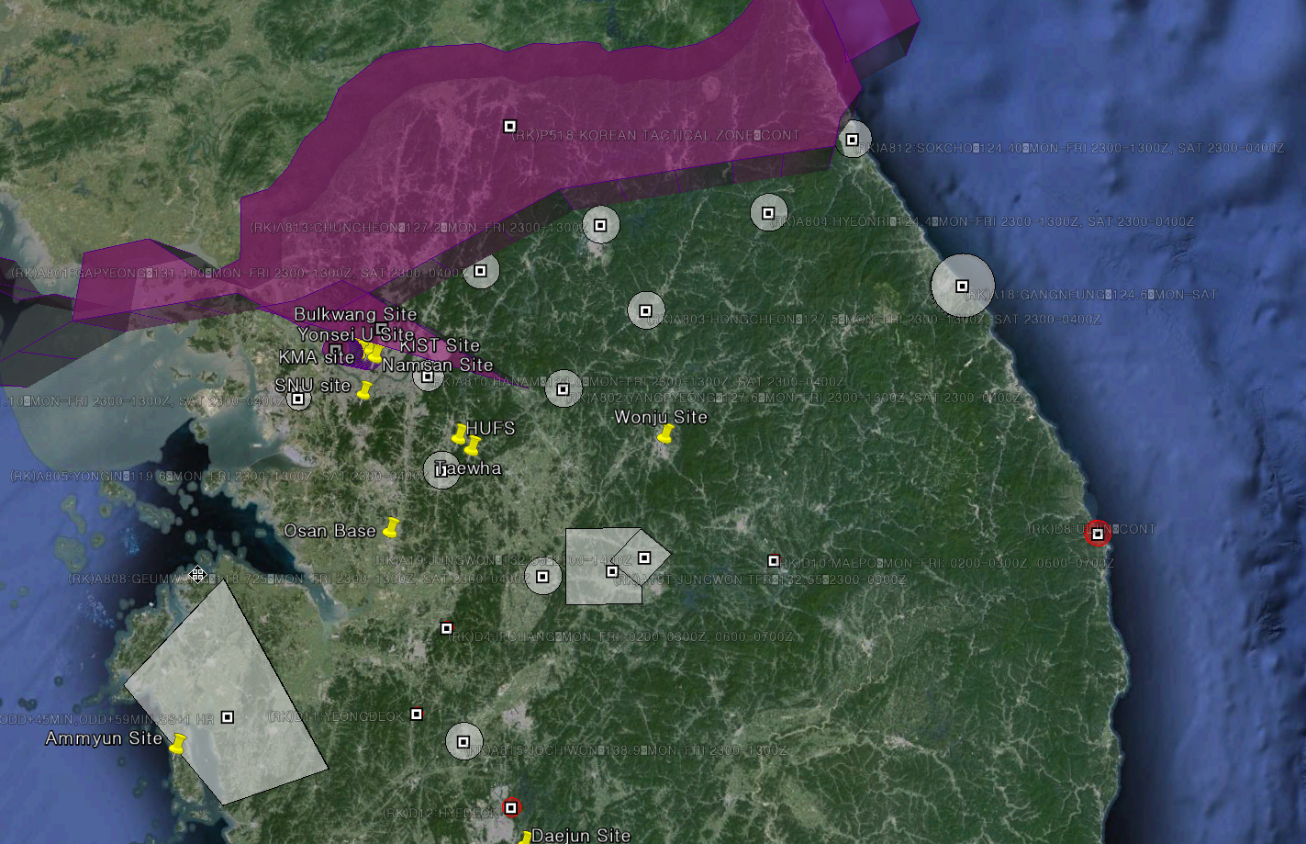
Weekend : Biogenic and urban downwind lagrangian

Slide 21
Overflight Coordination between the Aircraft and Ground Sites
Scientifically, it is highly desirable to have overflight, including vertical profiling, over the ground sites.
Current ground sites for the pre-campaign present significant airspace difficulties that will limit overflight altitudes and the level of proximity that can be achieved.
We are not considering overflight of Baengnyeong Island or Yonsei University at this time unless there is knowledge on how they might be successfully requested.
The following slides show the specific limitations at the remaining pre-campaign ground sites.

Slide 22
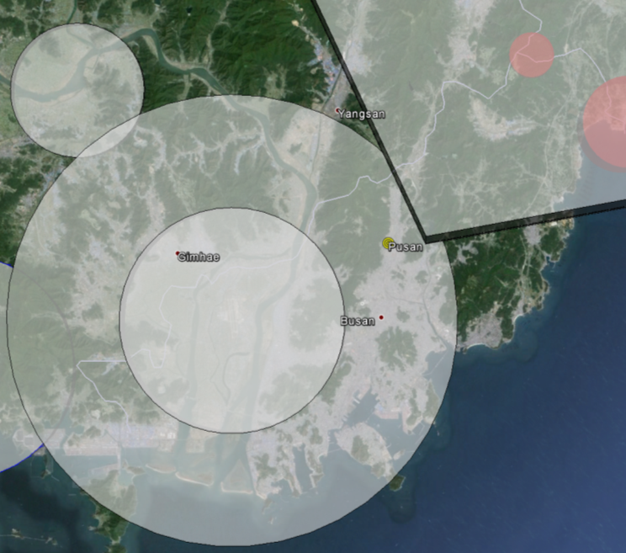
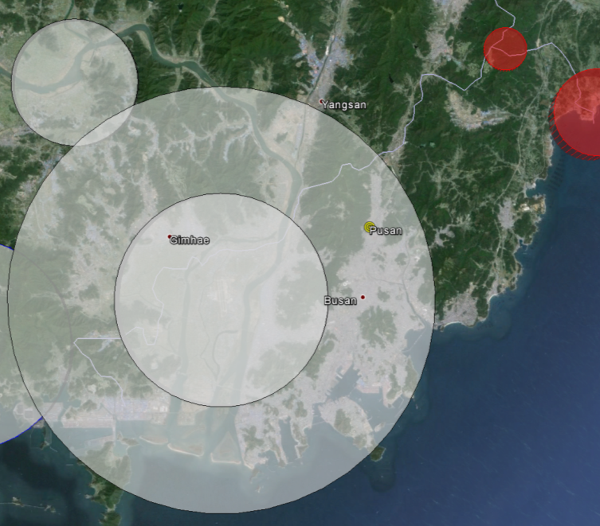
Airspace over the Pusan site
Weekday Weekend
This site lies within the Class C airspace for Gimhae airport. No access below 5000 feet.

Slide 23
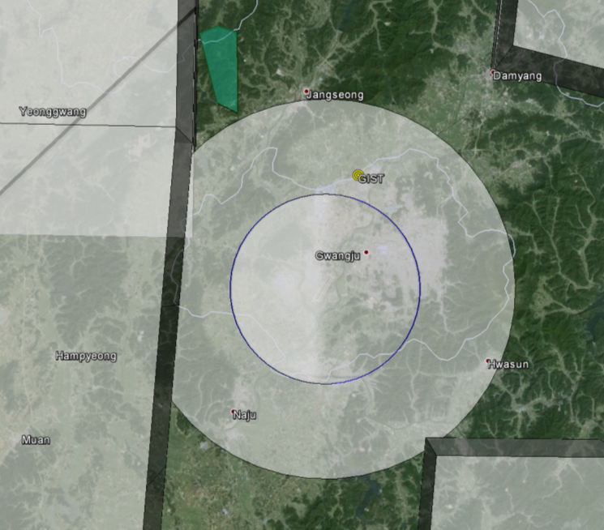
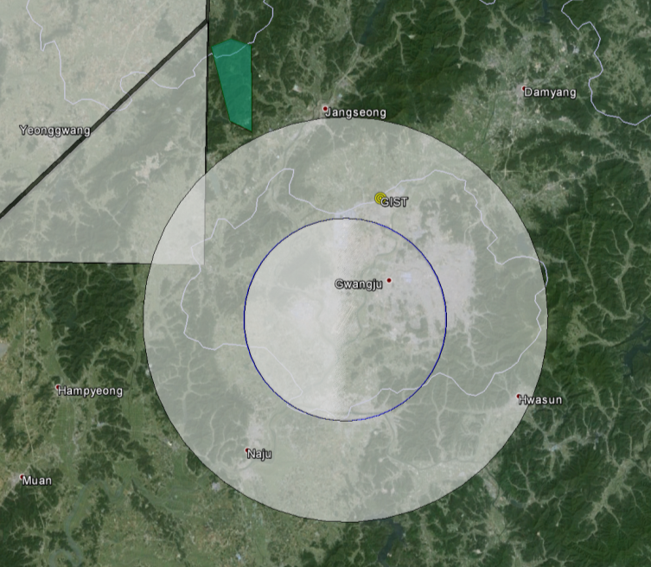
Airspace over the GIST site
Weekday Weekend
This site lies within the Class C airspace for Gwangju airport. No access below 5000 feet.

Slide 24
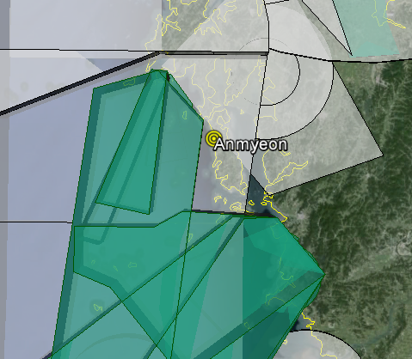
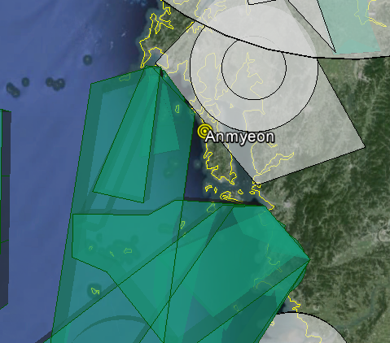
Airspace over the Anmyeon site
Weekday Weekend
Navigation to this site could be possible, but complicated on weekends.

Slide 25
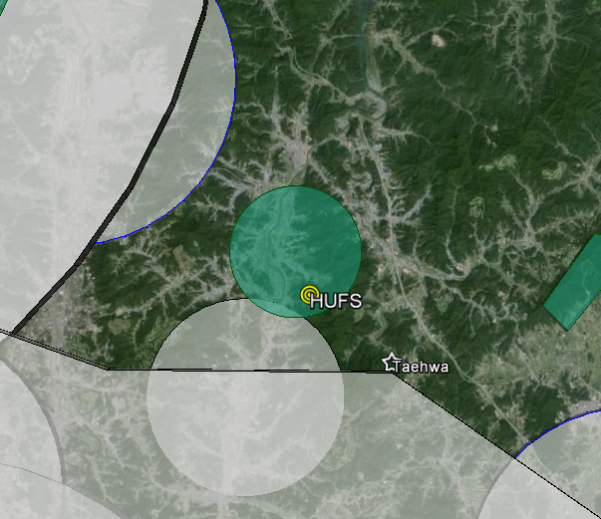
Airspace over the HUFS site
Weekday Weekend
This site lies within a restricted area. No access below 2500 feet. Overflight of the Taewha Forest site appears feasible.

Slide 26
Open Questions and Issues for Research Flights (1)
The current plans do not allow for night flights. Quiet hours at Osan are from 2200-0600, meaning that no take-offs or landings are allowed during this time. Any exception would require a waiver and potential fines from the Korean government.
The current plans do not allow for extensive mapping at low altitude. This would require special requests from the ROK Air Force.
The current plan does not allow for vertical profiling over the ground sites. Is overflight at a few selected altitudes sufficient? Should we try to conduct missed approaches to reach lower altitudes adjacent to ground sites near airports?
For the NASA King Air, what balance should we seek for mapping the SMA versus following the jetways?

Slide 27
Open Questions and Issues for Research Flights (2)
Given the complex airspace and number of different controlling authorities, we need assistance on the NASA aircraft from Korean pilots who can assist with radio traffic and language translation. Are such personnel available?
Lidar operations do not appear to be regulated, but it is important that we be clear on our procedures.
We plan to visit to the Korean Air Traffic authorities to explain our flight strategies and ask for their help (week of 18 January). These meetings should include both flight crew and scientists. A follow-up visit just prior to the campaign may be very helpful.

